Slide 1
M10L3 Task 2

Slide 2
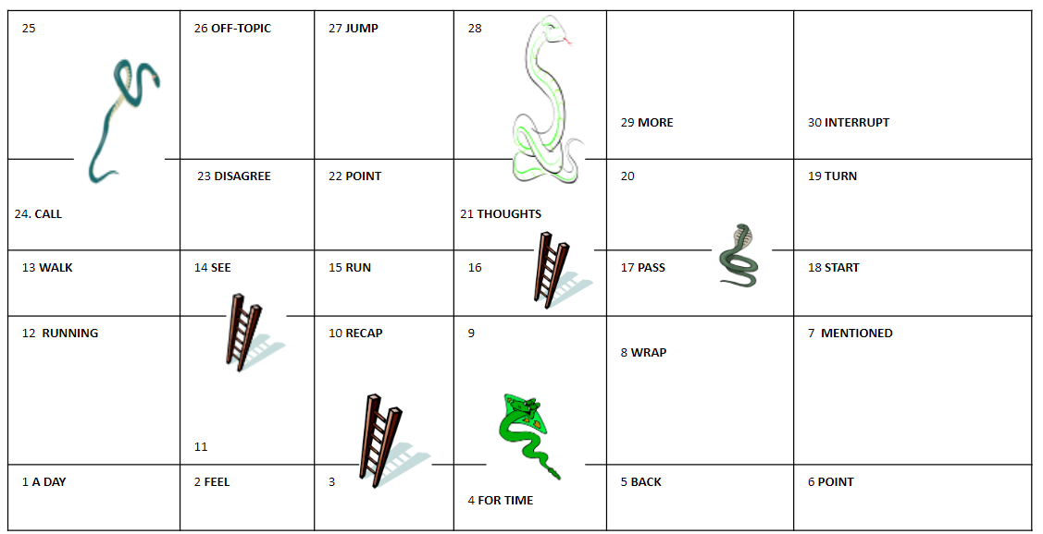
1
Roll the dice here.

Slide 3
1
Roll the dice here.

Slide 4
1
Roll the dice here.

